Slide 1
P2P Communication System
- By Halen Whiston
Shalini Bhattacharjee

Slide 2
OBJECTIVE
To build up an application which can handle peer-to-peer communication using causal ordering, assuming that the communication is reliable, no fault tolerance and no process can join or leave the communication.

Slide 3
APPLICATION OVERVIEW
The main thread generates and acts as different processes (P0, P1, P2).
The main thread works on vector clock, sender and the GUI.
Each process has two threads-
Listener thread-
Receiver thread-
A holder queue – attached to listener where messages get delivered and the listener retrieves those when it wakes up from its sleep period.
A vector clock- attached to sender, upon sending a message it gets incremented by 1.

Slide 4
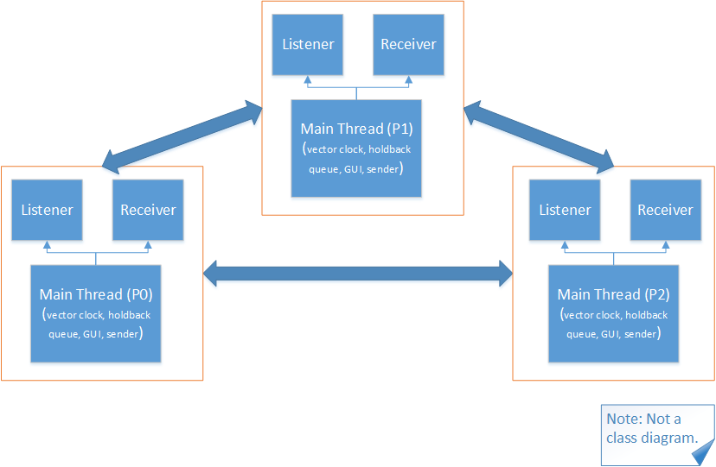
DIAGRAMMATIC LAYOUT

Slide 5
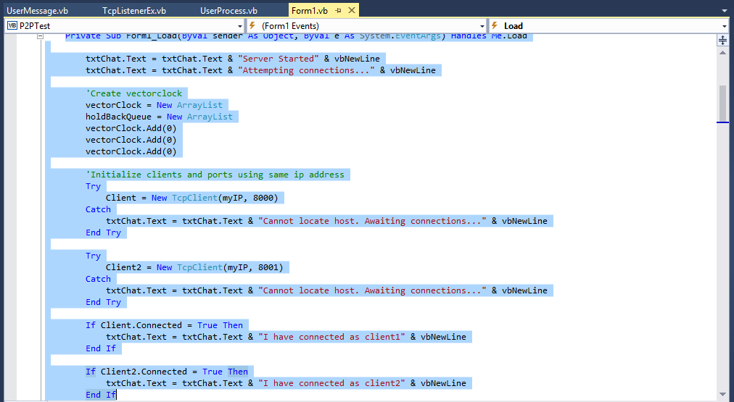
MAIN THREAD
Here connections among processes are established

Slide 6
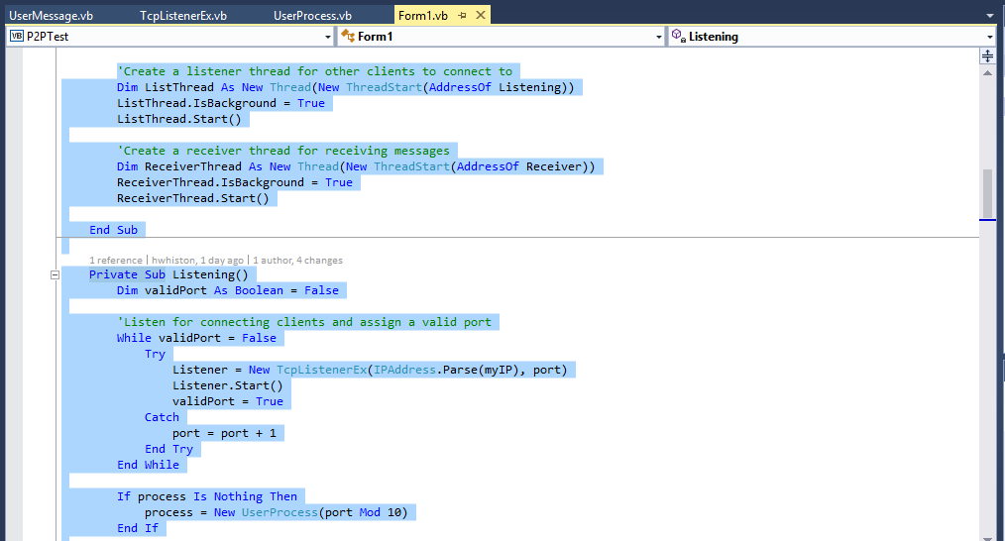
LISTENER
The listener thread created listens for connection and assign a valid port

Slide 7
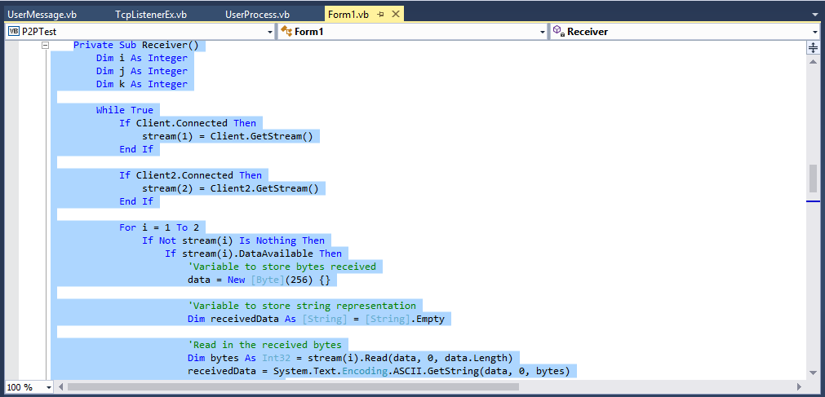
RECEIVER
The receiver receives the message from different processes

Slide 8
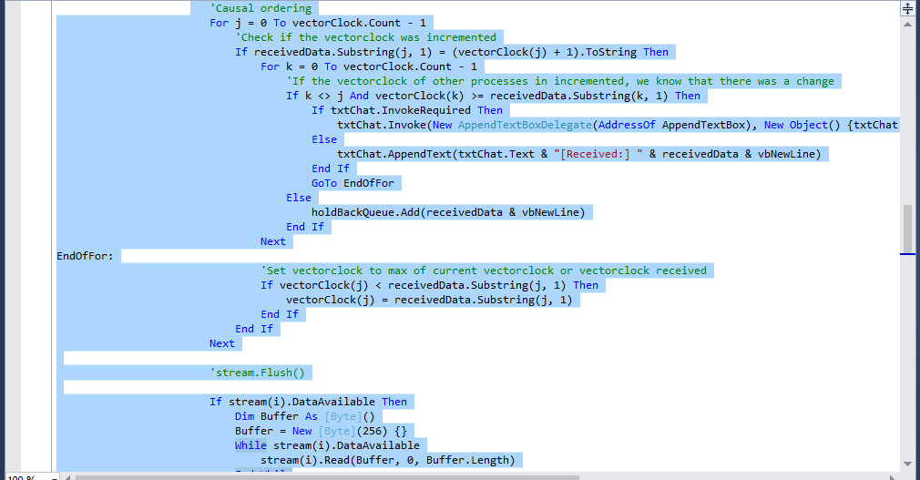
CAUSAL ORDERING
Updating the vector clock and the message queues after a message is sent

Slide 9
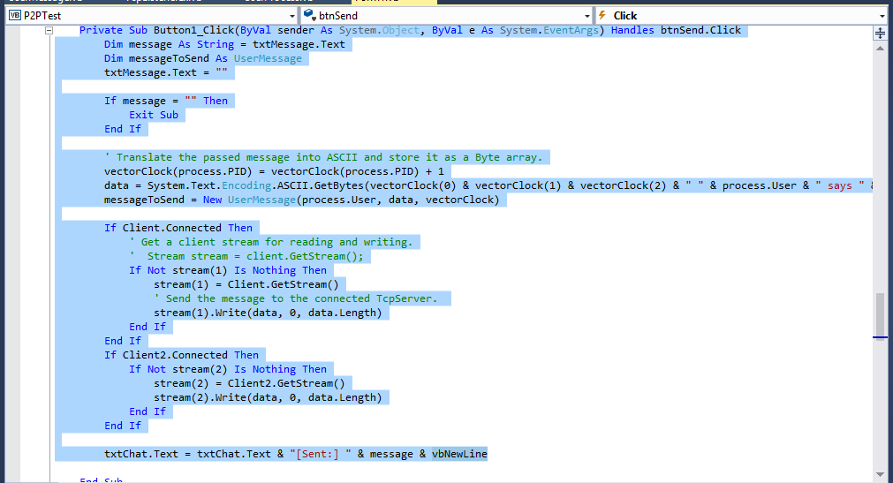
SEND BUTTON
Message structure as who said what

Slide 10
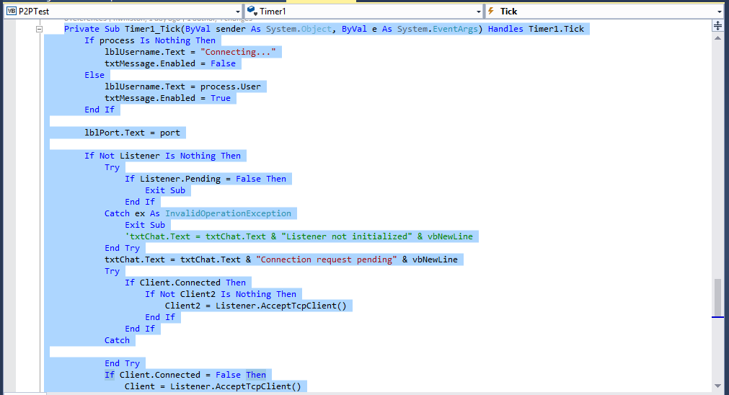
TIMER

Slide 11
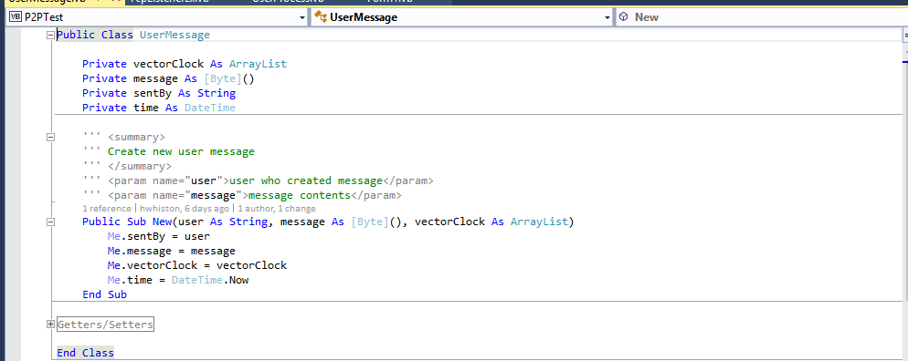
USER MESSAGE
Defining the components of a new message

Slide 12
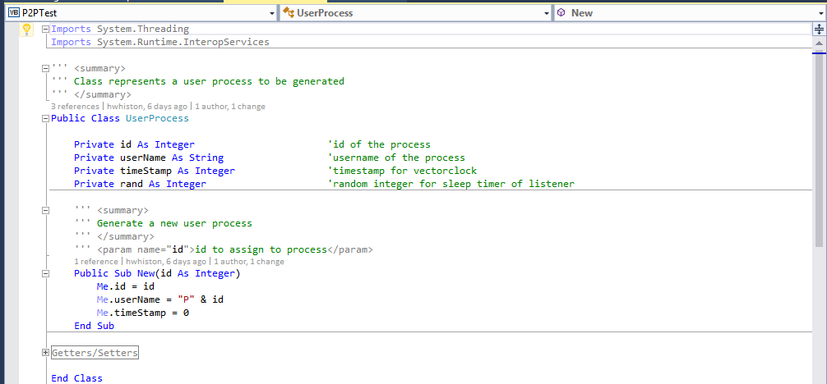
USER PROCESS
Generating a new userprocess

Slide 13
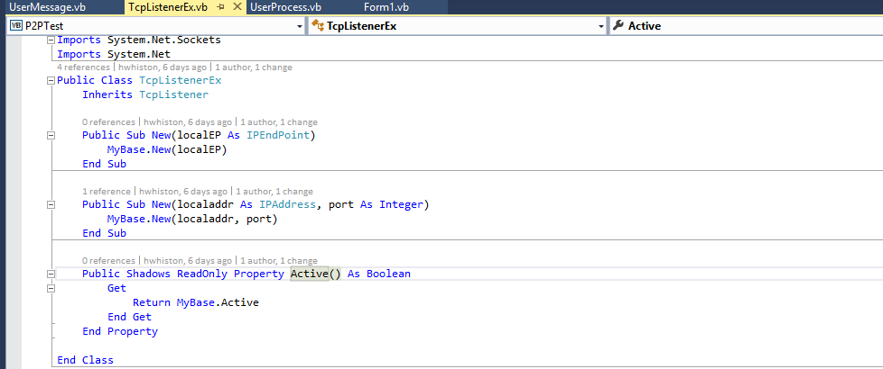
TCP LISTENER
The listener compare the last message count to new message in holder, simulates
network lag

Slide 14
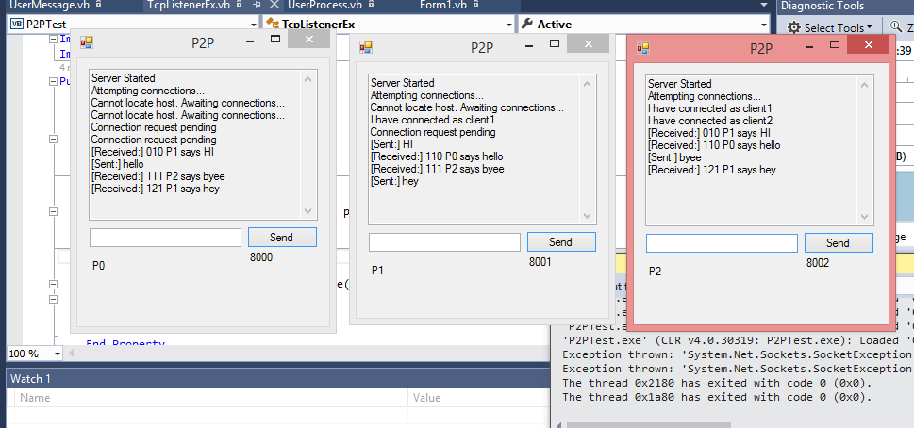
OUTPUT

Slide 15
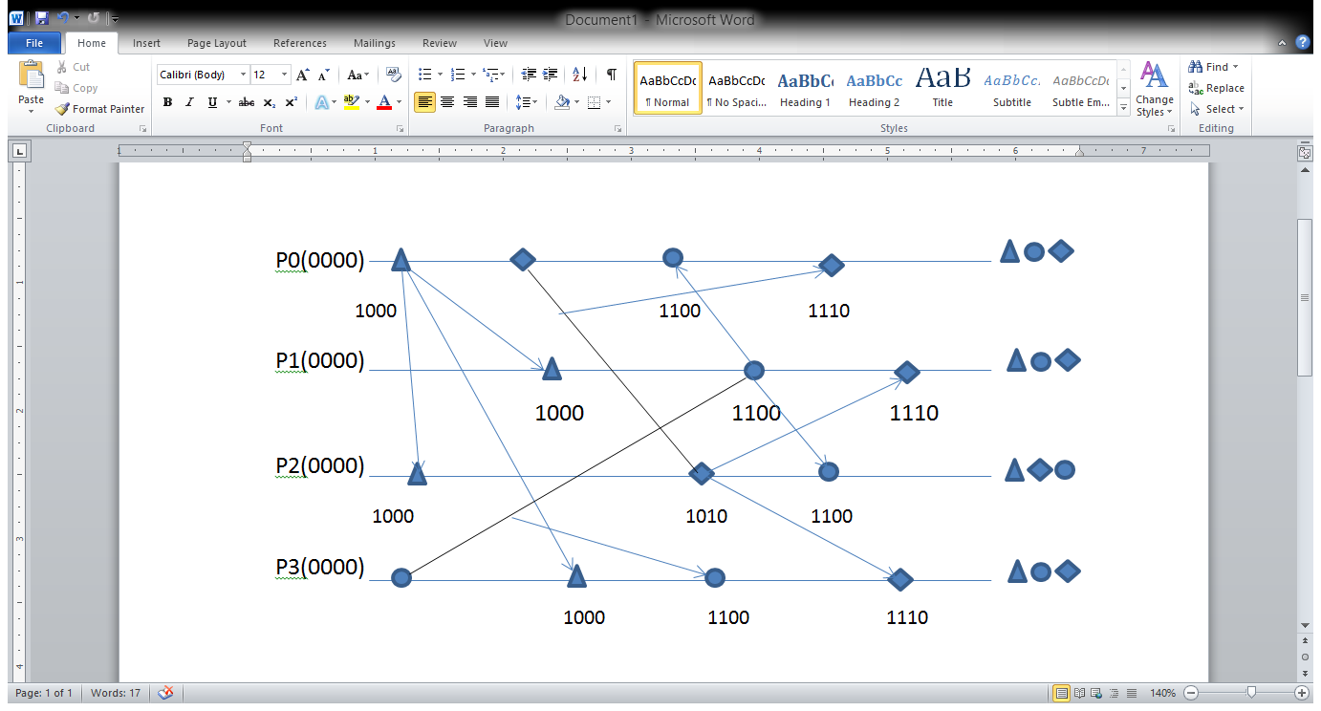
HOW MESSAGES ARE DELIVERED?

Slide 16
RESULTS
Broadcast- based: Even when a process P1 needs to send a message only to P0, the message has to be sent to all other processes in the system
send (P0)-> send (P1)-> receive (P1)-> send(P2)
So send(P0) and send (P2) are causally related. When two messages sent to a process are causally related, they should be in the same order.
There is no increment on receiving

Slide 17
THANK YOU!

